Slide 1




The predictive value of small short-term creatinine increases detected by arterial blood gases in ICU
Lisa Toh^{1,2}, Alwin Wang³, Laurent Bitker^{1,4}, Glenn Eastwood^{1,2}, Rinaldo Bellomo^{1,2,3}
1. |  | Department of Intensive Care, Austin Health, Heidelberg, Australia
2. |  | The Australian and New Zealand Intensive Care Research Centre, School of Public Health and Preventive Medicine, Monash University, Melbourne, Australia
3. |  | Data Analytics Research and Evaluation (DARE) Centre, Melbourne University and Austin Hospital, Melbourne, Australia
4. |  | Université de Lyon, CREATIS CNRS UMR5220 INSERM U1044 INSA-Lyon, France

Slide 2
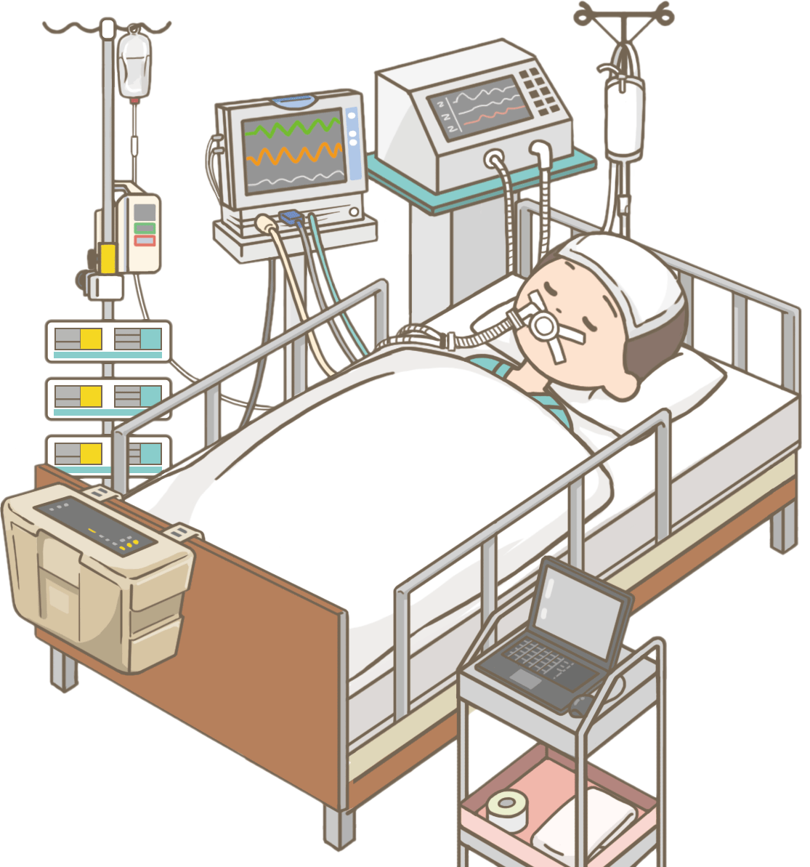

Slide 3

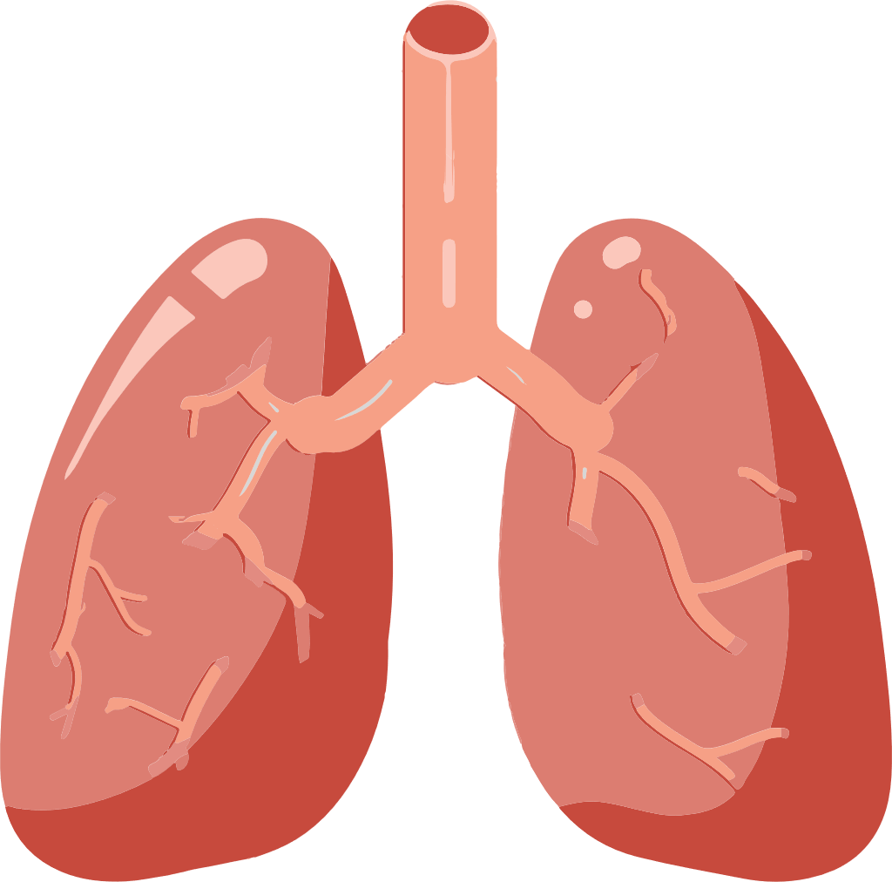
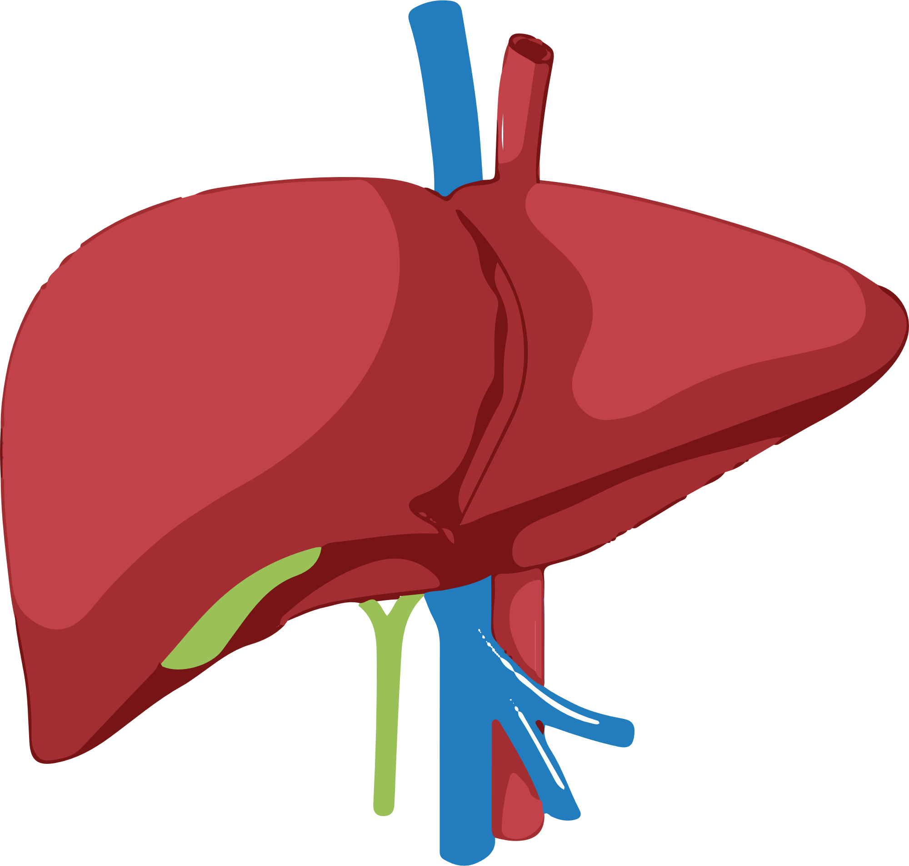
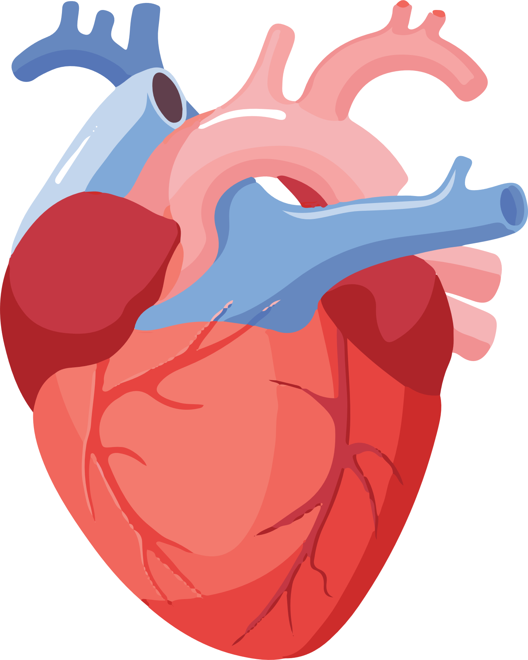
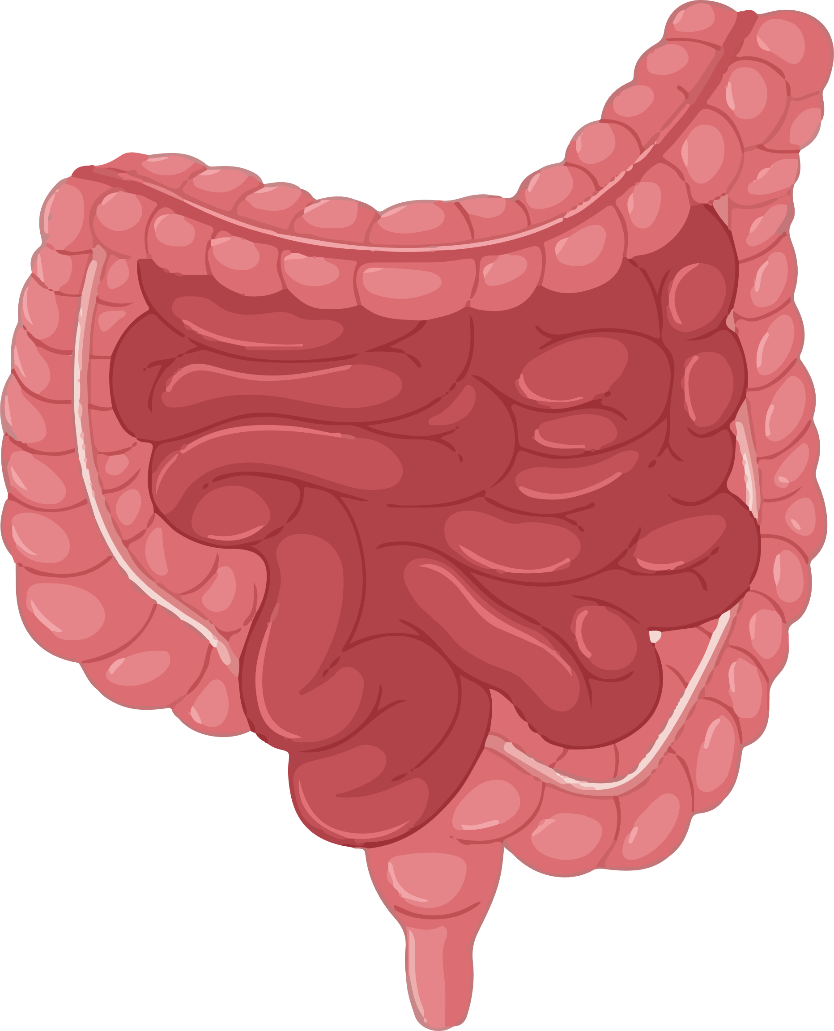
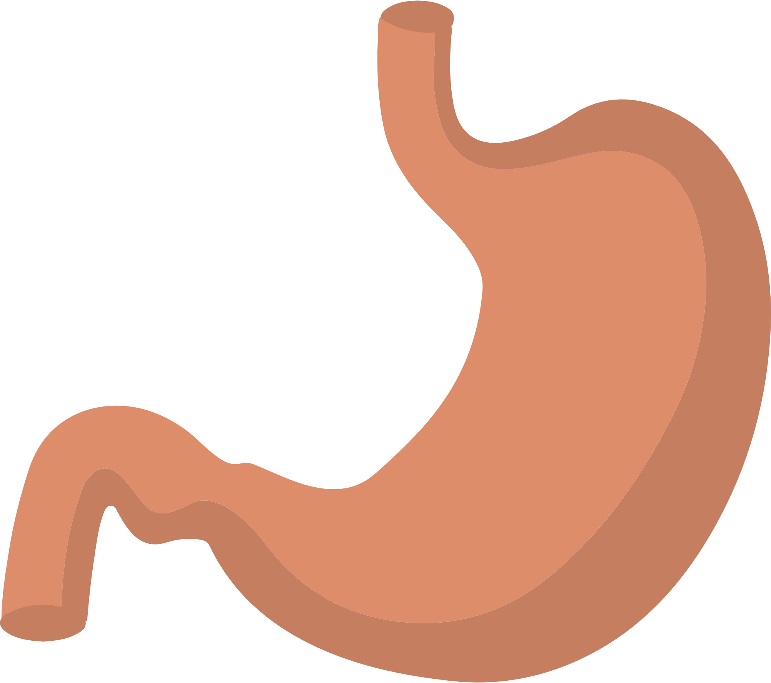
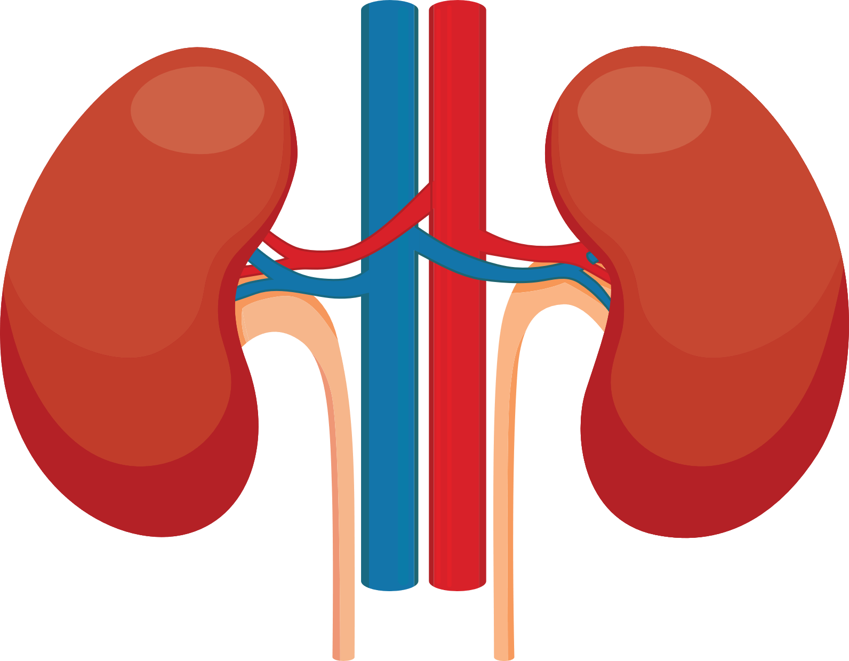

Slide 4
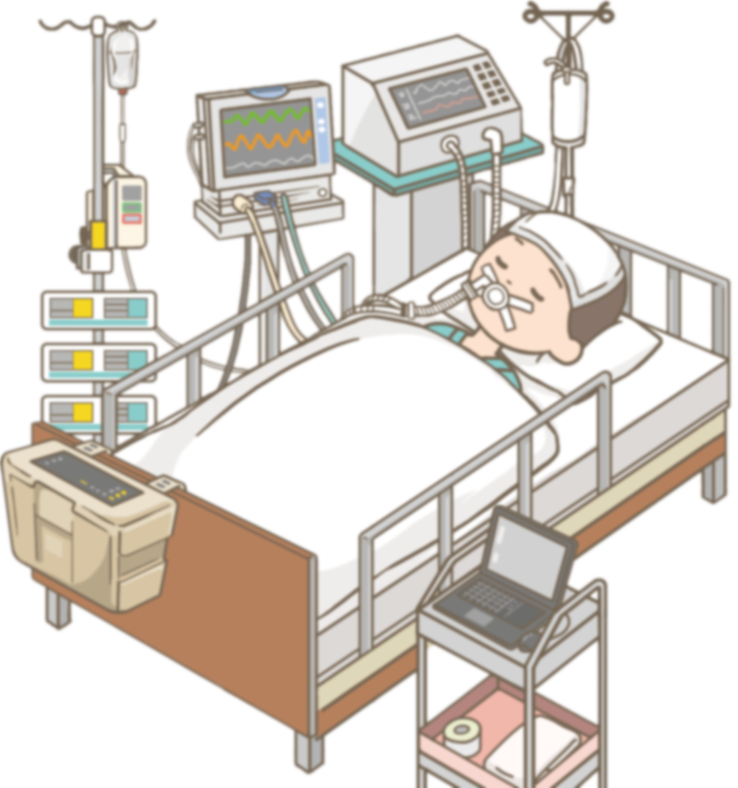

Slide 5
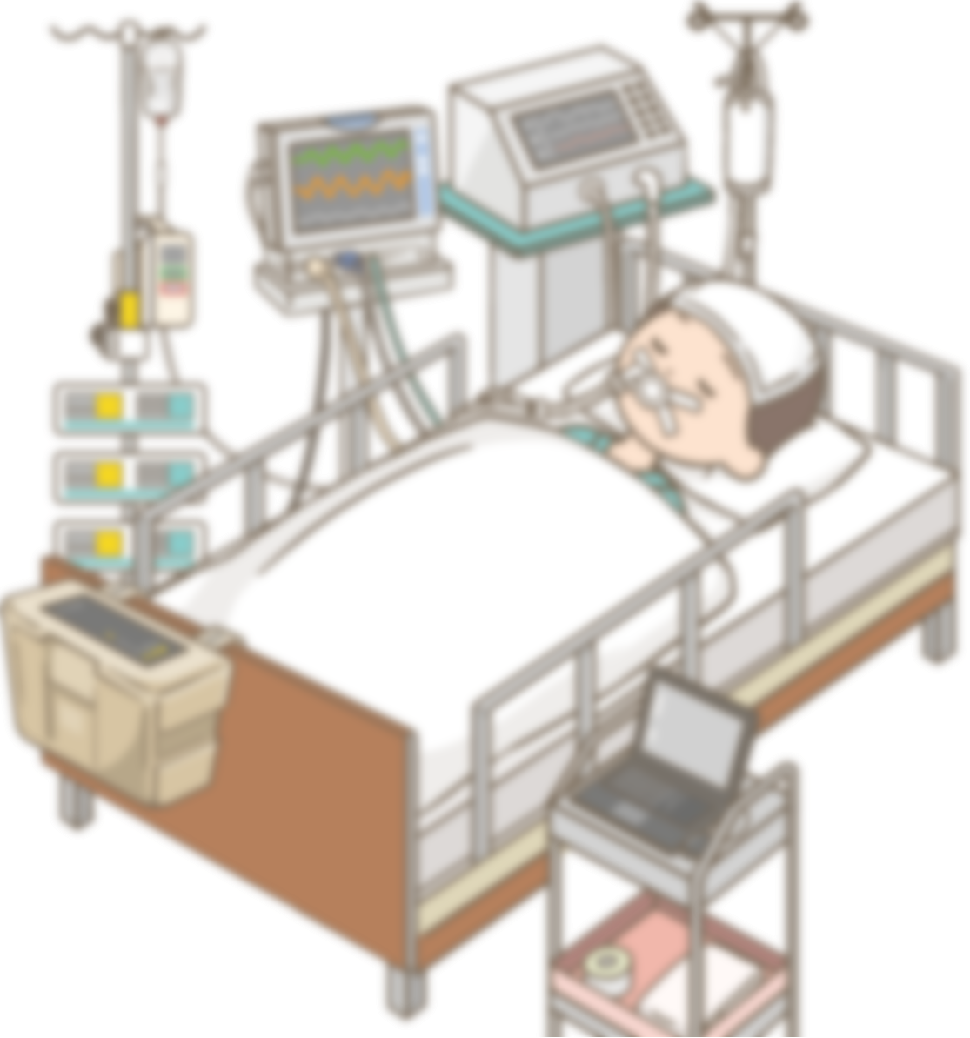


Slide 6
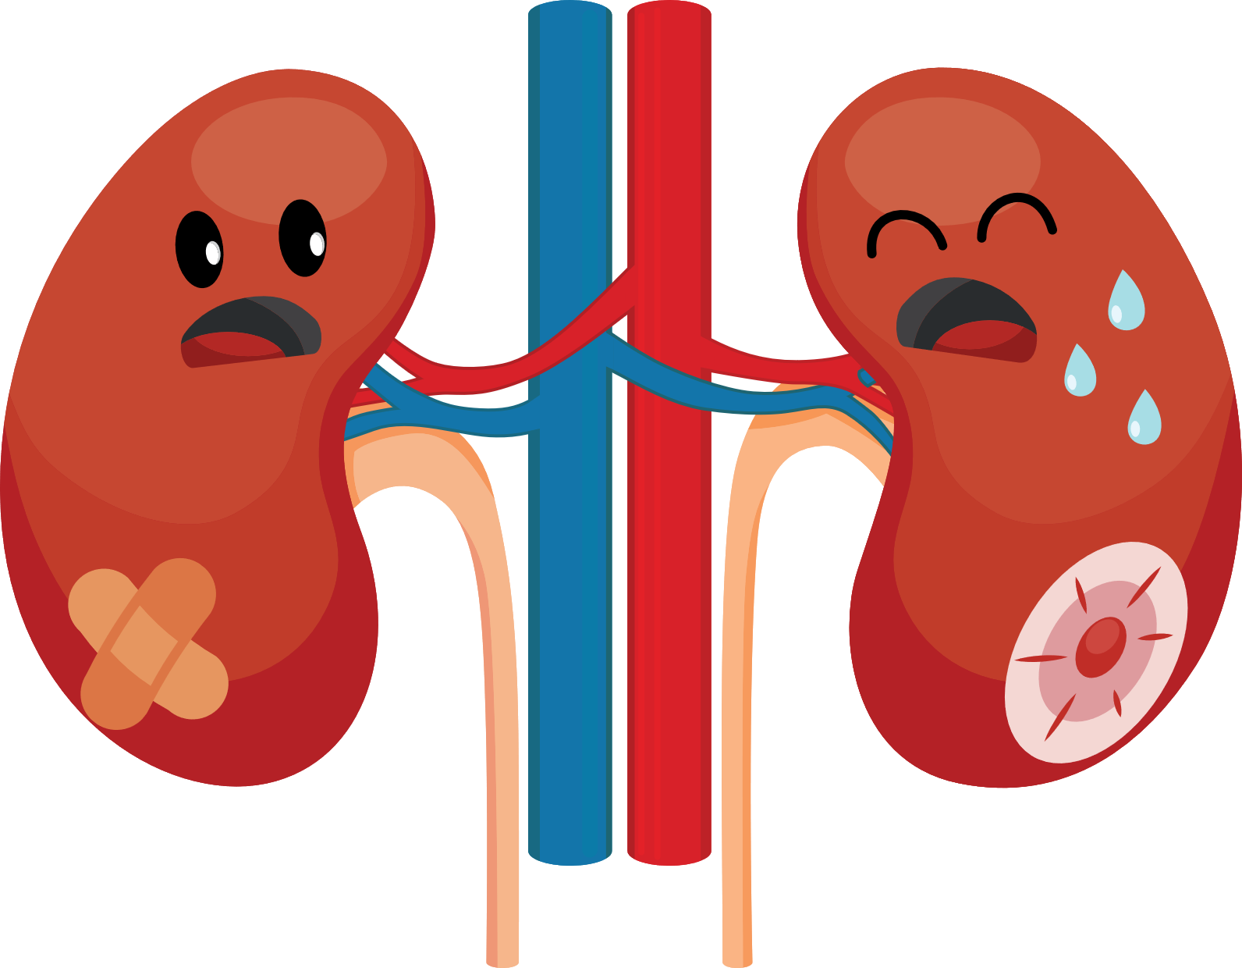
Acute Kidney Injury (AKI)

Slide 7




Acute Kidney Injury (AKI)

Slide 8
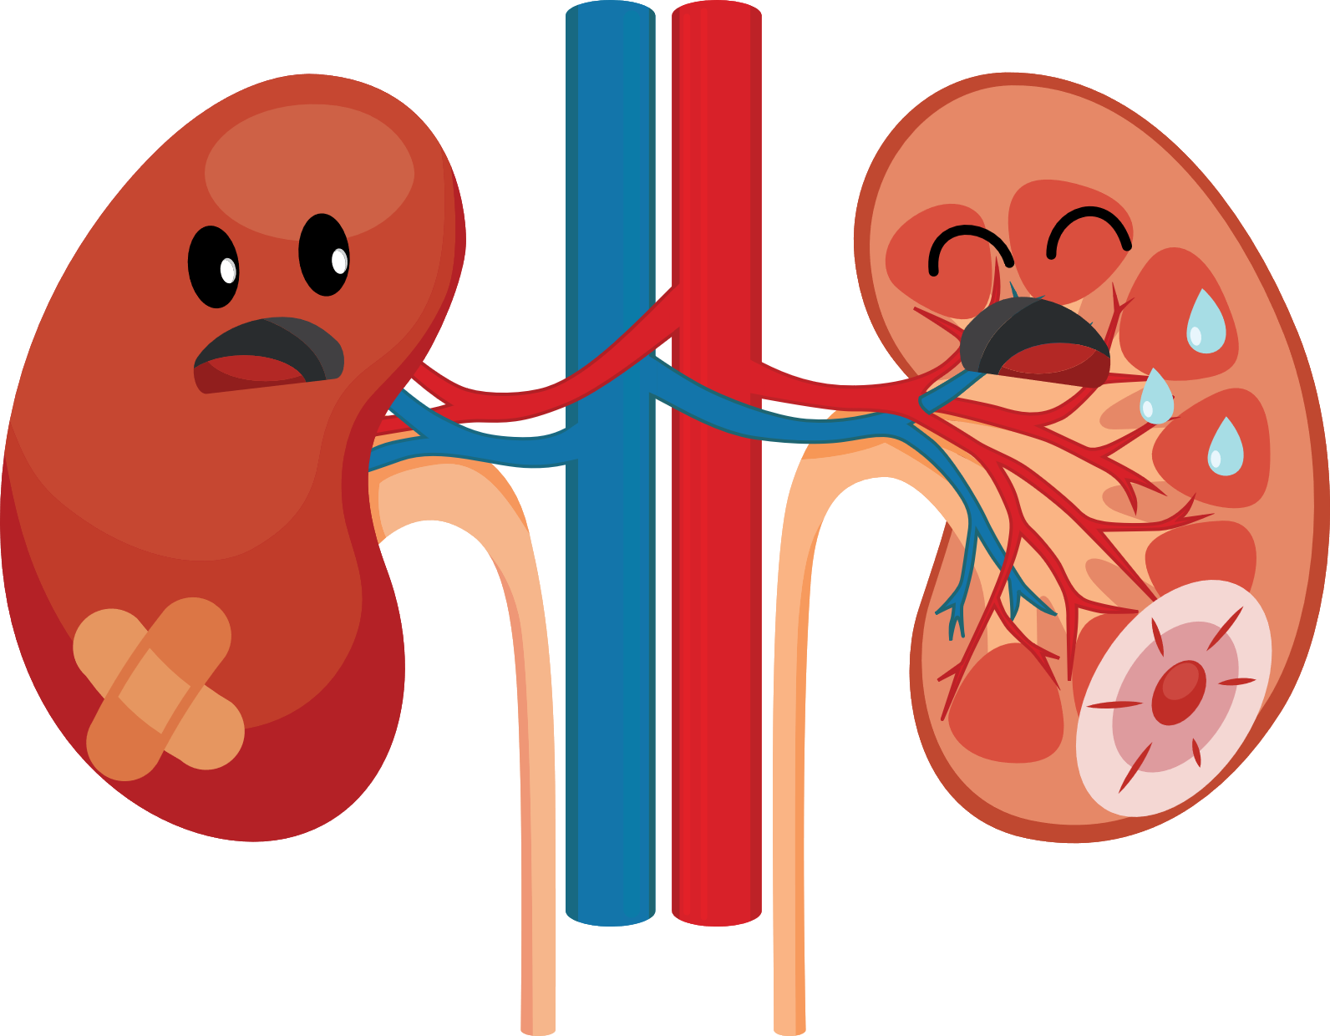



Acute Kidney Injury (AKI)
Clinical Practice Guideline for Acute Kidney Injury

Slide 9



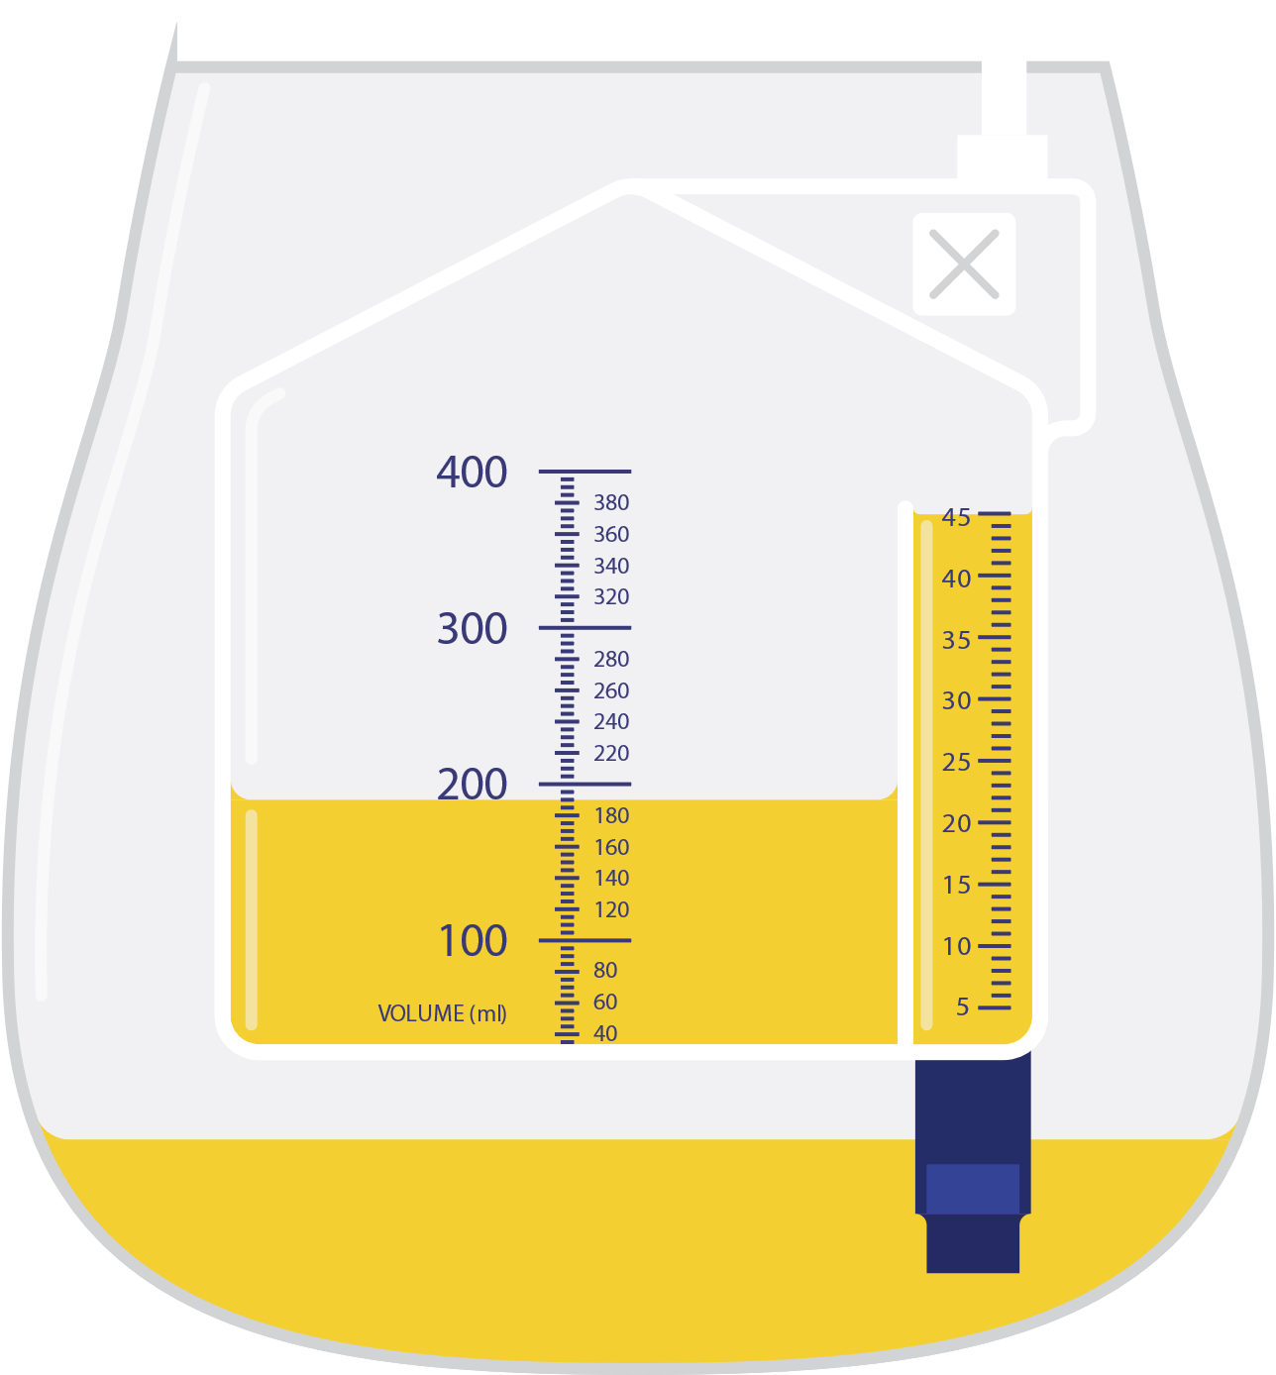

Slide 10
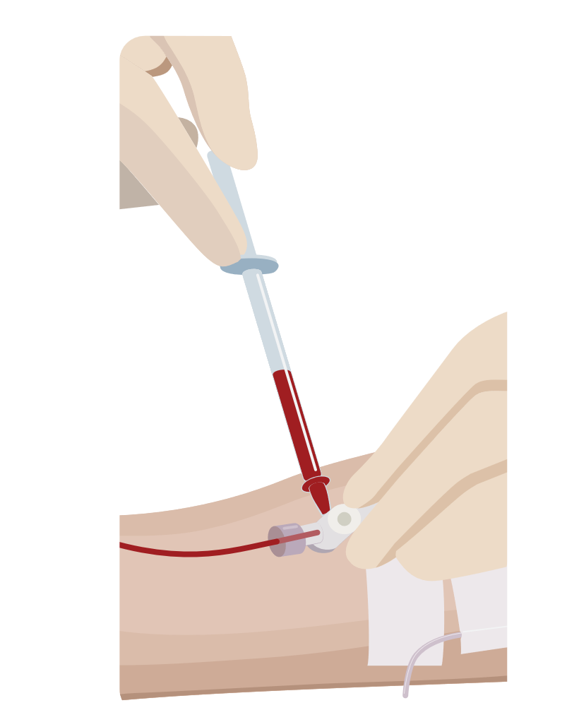

Slide 11
830

Slide 12
830
384

Slide 13
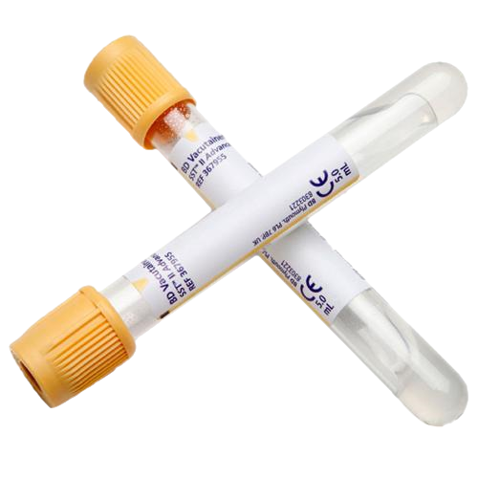
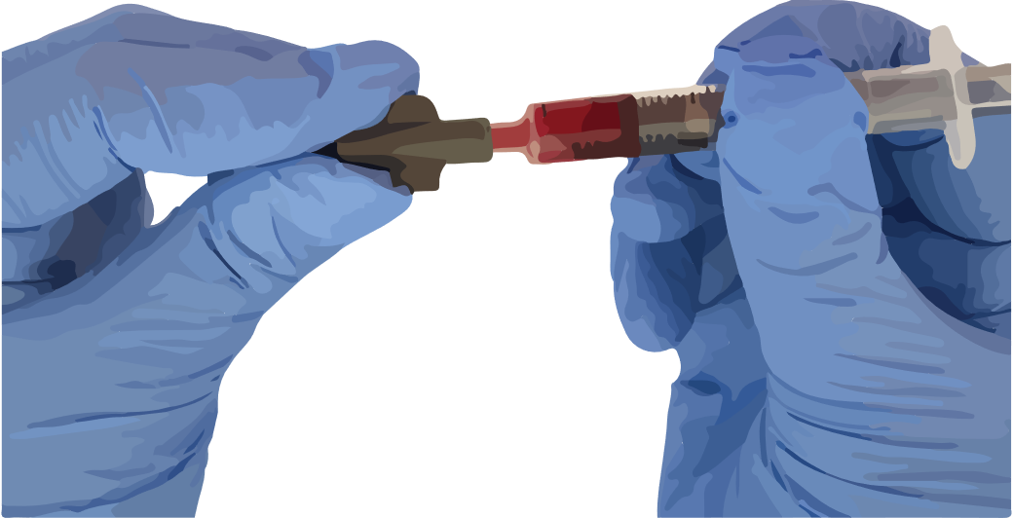
3960

Slide 14
71499

Slide 15
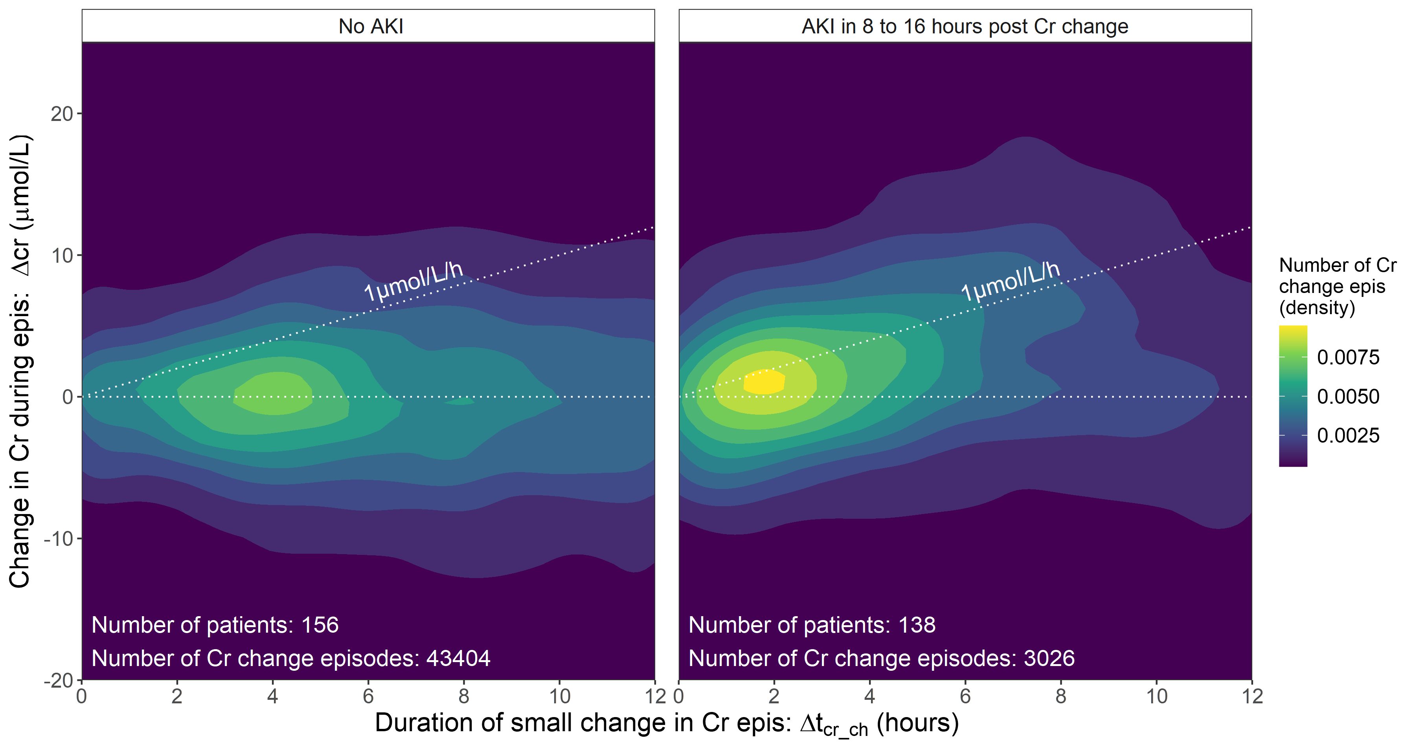

Slide 16
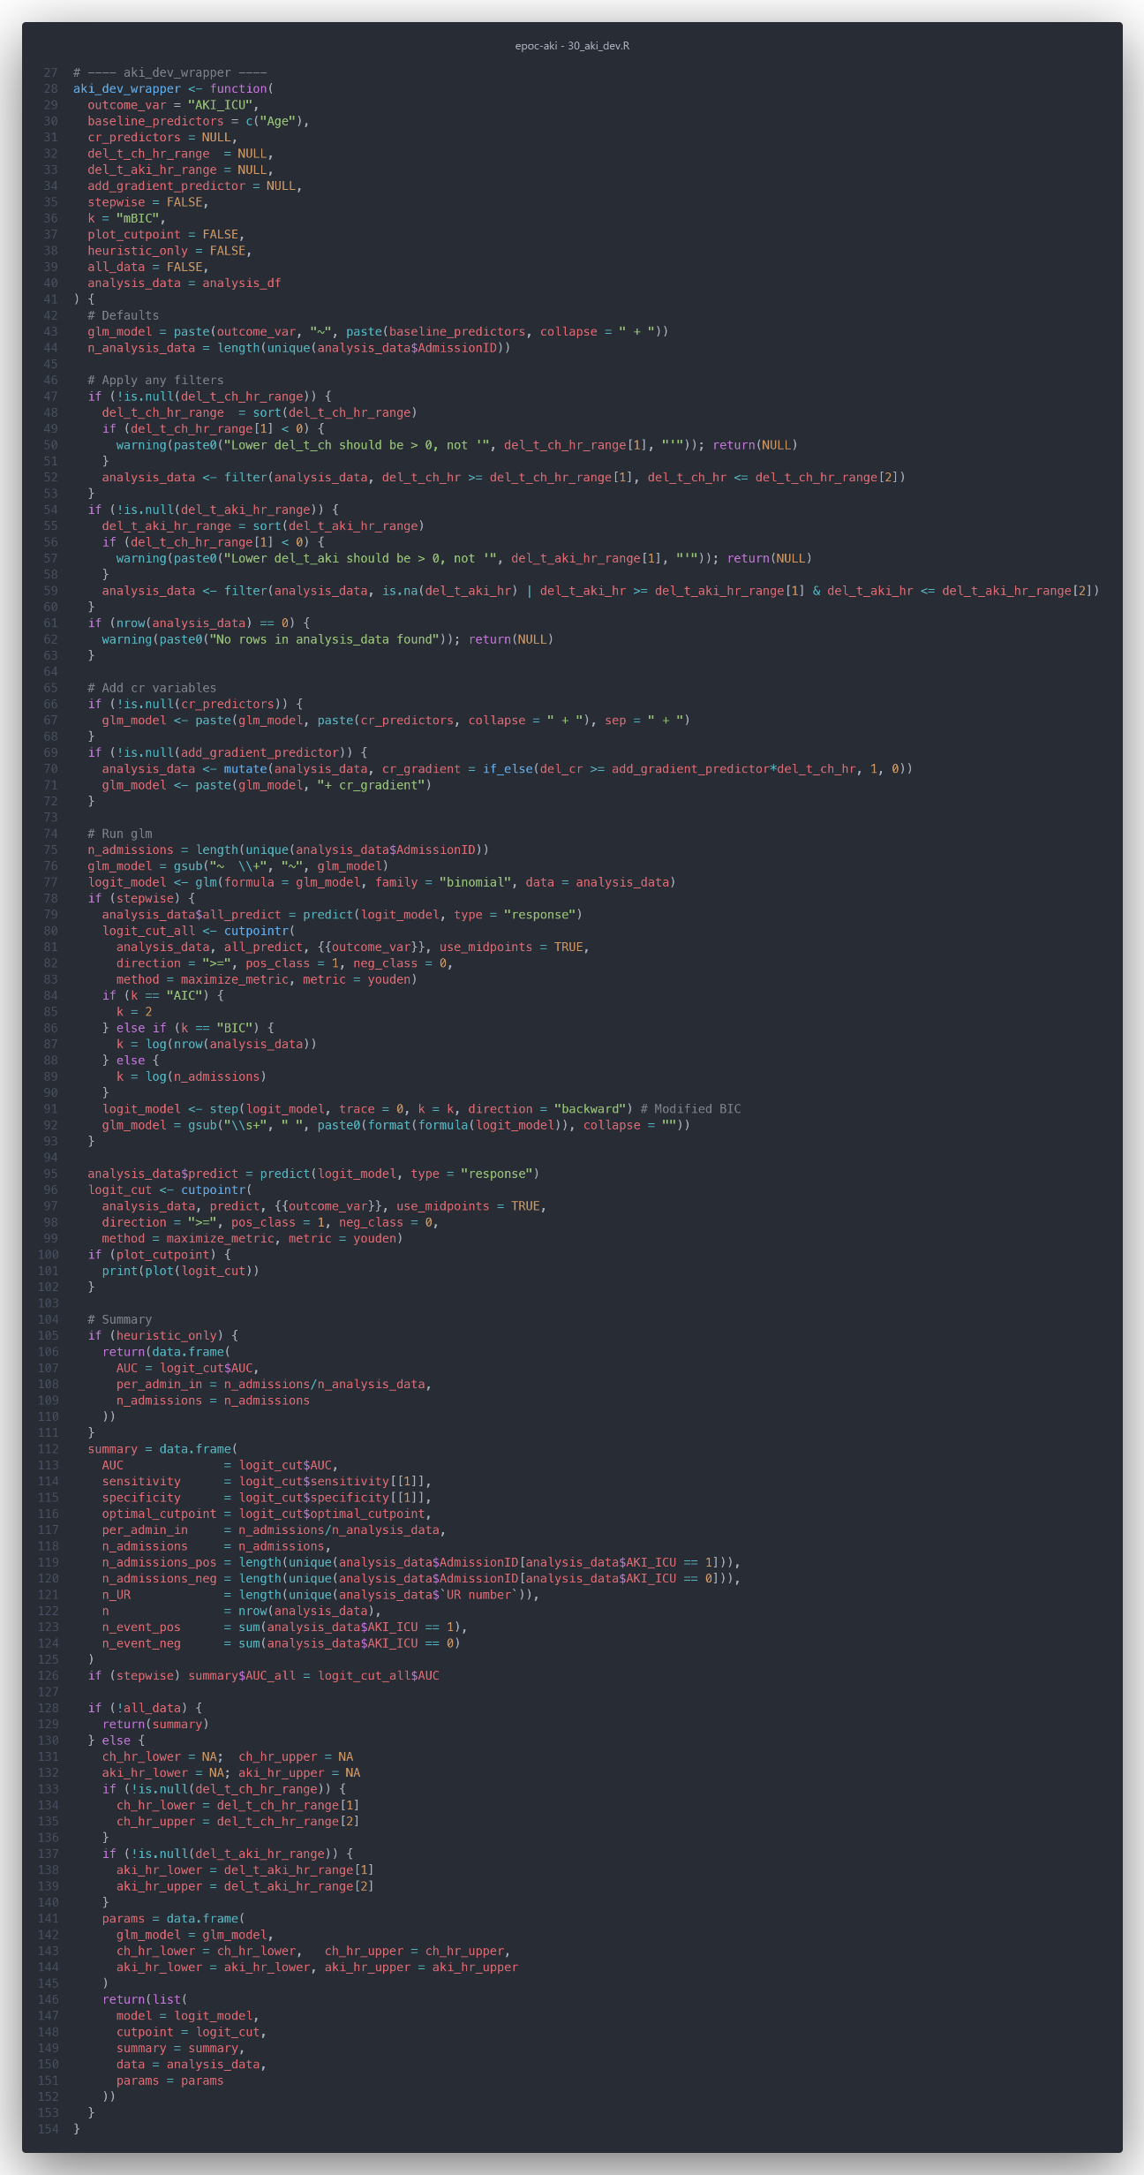

Slide 18
Variable | Odds Ratio | CI.95 | p-Value
Age | 0.98 | [0.96;1.00] | 0.0230
Diabetes | 3.29 | [1.91;5.69] | < 1e-04
Chronic liver disease | 38.57 | [13.01;114.31] | < 1e-04
Cardiac surgery | 3.74 | [2.08;6.71] | < 1e-04
Vasopressors | 3.40 | [2.04;5.64] | < 1e-04
APACHE II score | 0.88 | [0.80;0.98] | 0.0145
APACHE III score | 1.06 | [1.02;1.09] | 0.0004
Creatinine change | 3.14 | [1.82;5.43] | < 1e-04

Slide 19
Variable
Odds Ratio
CI.95
p
-
Value
Age
0.98
[0.96;1.00]
0.0230
Diabetes
3.29
[1.91;5.69]
< 1e
-
04
Chronic liver disease
38.57
[13.01;114.31]
< 1e
-
04
Cardiac surgery
3.74
[2.08;6.71]
< 1e
-
04
Vasopressors
3.40
[2.04;5.64]
< 1e
-
04
APACHE III score
1.06
[1.02;1.09]
0.0004
Creatinine change
3.14
[1.82;5.43]
< 1e
-
04

Slide 20
AKI in 8 to 16 hours
Multivariable Model
Sensitivity: 82%
Specificity: 74%
AUROC: 0.85
78
70
≥1 μmol/L/h
Ch change: 6 to 7 Hours
Intervention Possible: 8 to 16 hours post Cr change

Slide 22
